Slide 1
What is a Healthy Church?
The Importance of Knowing ‘What must be’!

Slide 2
Men from Issachar… understood the times and knew what Israel should do … 1 Chronicles 12:32
“If the heart of Christian Mission is to evangelize and transform culture through the centrality of the church, then understanding the culture is paramount.”
James Emery White
Meet Generation Z: Understanding and Reaching the New Post-Christian World Baker Publishing Group

Slide 3
LAW OF ORGANIZATIONAL LIFE #1
Without ongoing assessment & focused intervention two things will always happen:
Mission will always drift!
Vision will continually leak!

Slide 4
LAW OF ORGANIZATIONAL LIFE #2
“The strongest force in an organization is not vision or strategy – it is the culture which holds all the other components.”
Samuel Chand

Slide 5
LAW OF ORGANIZATIONAL LIFE #2
“The fact is, culture eats strategy for lunch. You can have a good strategy in place, but if you don’t have the culture and the enabling systems, the [negative] culture of the organization will defeat the strategy.”
Dick Clark or Peter Drucker

Slide 6
ASSUMPTIONS

Slide 7
ASSUMPTIONS:
That which is healthy Grows and Reproduces
“So neither he who plants nor he who waters is anything, but only God, who makes things grow. …I laid a foundation as an expert builder…”
1 Cor 3:5–15
Notes:
1 Corinthians 3:5–15 (NIV84)
⁵ What, after all, is Apollos? And what is Paul? Only servants, through whom you came to believe—as the Lord has assigned to each his task. ⁶ I planted the seed, Apollos watered it, but God made it grow. ⁷ So neither he who plants nor he who waters is anything, but only God, who makes things grow. ⁸ The man who plants and the man who waters have one purpose, and each will be rewarded according to his own labor. ⁹ For we are God’s fellow workers; you are God’s field, God’s building.
¹⁰ By the grace God has given me, I laid a foundation as an expert builder, and someone else is building on it. But each one should be careful how he builds. ¹¹ For no one can lay any foundation other than the one already laid, which is Jesus Christ. ¹² If any man builds on this foundation using gold, silver, costly stones, wood, hay or straw, ¹³ his work will be shown for what it is, because the Day will bring it to light. It will be revealed with fire, and the fire will test the quality of each man’s work. ¹⁴ If what he has built survives, he will receive his reward. ¹⁵ If it is burned up, he will suffer loss; he himself will be saved, but only as one escaping through the flames.

Slide 8
ASSUMPTIONS:
Jesus Christ did not establish the church for Christians, but to mobilize Christians to reach people apart from God
“… on this rock I will build my church, and the gates of Hades will not overcome it.”
Matt.16:18
Notes:
Matthew 16:16–18 (NIV84)
¹⁶ Simon Peter answered, “You are the Christ, the Son of the living God.”
¹⁷ Jesus replied, “Blessed are you, Simon son of Jonah, for this was not revealed to you by man, but by my Father in heaven. ¹⁸ And I tell you that you are Peter, and on this rock I will build my church, and the gates of Hades will not overcome it.
John 17:18 (NIV84)
¹⁸ As you sent me into the world, I have sent them into the world.
Luke 19:10 (NIV84)
¹⁰ For the Son of Man came to seek and to save what was lost.”

Slide 9
ASSUMPTIONS:
The Gospel never changes but the church & region must change constantly
Notes:
"Marry your mission. Date your model. Fall in love with your vision. Stay mildly infatuated by your approach" (Andy Stanley).

Slide 10
ASSUMPTIONS:
"Marry your mission. Date your model. Fall in love with your vision. Stay mildly infatuated by your approach.”
Andy Stanley

Slide 11
Three Characteristics of Healthy Organizations
1. MISSION DRIVEN (Purpose) -
Clarity of an Externally Focused Purpose or Mission
Great Commandment/Great Commission Based
Laser Focused - Broadly Embraced – Thoroughly Integrated - Repeatedly Communicated – Joyously Celebrated
Used as the Basis of Accountability at all Levels of Church Ministry

Slide 12
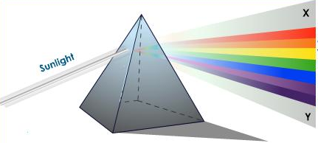
Three Characteristics of Healthy Organizations
Churches and Regions are not hurting for lack of vision, but for lack of a unifying and compelling vision - A Great Commission Vision.
Jesus turned and said to Peter, “Get behind me, Satan! You are a stumbling block to me; you do not have in mind the things of God, but the things of men.”
Matthew 16:23
MISSION
ISSUE or BELIEF
Missional Dispersion

Slide 13
Three Characteristics of Healthy Organizations
2. MISSIONAL (RELATIONAL) DISCIPLESHIP
Our understanding and methods of making disciples are failing to produce believers who are like Jesus in their Purity, Passion, and Pursuit.
Understanding that discipleship is not an END, but a MEANS TO A GREATER END.
It was he who gave some to be apostles, some to be prophets, some to be evangelists, and some to be pastors and teachers, to prepare God’s people for works of service, so that the body of Christ may be built up until we all reach unity in the faith and in the knowledge of the Son of God and become mature, attaining to the whole measure of the fullness of Christ. …. speaking the truth in love, we will in all things grow up into him who is the Head, that is, Christ. From him the whole body, joined and held together by every supporting ligament, grows and builds itself up in love, as each part does its work.
Ephesians 4:11–16

Slide 14
DISCIPLESHIP
Discipleship
ORTHODOXY
(Beliefs)
ORTHOPATHY
(Feelings)
ORTHOPRAXY
(Actions)
"As Christians we are often times educated way beyond the level of our obedience.”
Mark Batterson, Primal Fear
Notes:
Orthopathy – Feelings
2 Cor 9:6 Remember this: Whoever sows sparingly will also reap sparingly, and whoever sows generously will also reap generously. ⁷ Each man should give what he has decided in his heart to give, not reluctantly or under compulsion, for God loves a cheerful giver. ⁸ And God is able to make all grace abound to you, so that in all things at all times, having all that you need, you will abound in every good work.
Jas 1:2 Consider it pure joy, my brothers, whenever you face trials of many kinds, ³ because you know that the testing of your faith develops perseverance. ⁴ Perseverance must finish its work so that you may be mature and complete, not lacking anything.
Orthopraxy - Actions
James 2:19
¹⁹ You believe that there is one God. Good! Even the demons believe that—and shudder.
2 Corinthians 5:11-15
¹¹ Since, then, we know what it is to fear the Lord, we try to persuade men. What we are is plain to God, and I hope it is also plain to your conscience. ¹² We are not trying to commend ourselves to you again, but are giving you an opportunity to take pride in us, so that you can answer those who take pride in what is seen rather than in what is in the heart. ¹³ If we are out of our mind, it is for the sake of God; if we are in our right mind, it is for you. ¹⁴ For Christ’s love compels us, because we are convinced that one died for all, and therefore all died. ¹⁵ And he died for all, that those who live should no longer live for themselves but for him who died for them and was raised again.
Philippians 2:5-8
⁵ Your attitude should be the same as that of Christ Jesus: (Let this mind be in you which was also in Christ Jesus)
⁶ Who, being in very nature God, did not consider equality with God something to be grasped, ⁷ but made himself nothing, taking the very nature of a servant, being made in human likeness. ⁸ And being found in appearance as a man, he humbled himself and became obedient to death— even death on a cross!

Slide 15
KINGDOM CONCEPT Church Unique – Will Mancini
LOCAL PREDICAMENT
What are the unique needs and opportunities where God has placed us?
COLLECTIVE POTENTIAL
What are the unique resources and capabilities that God brings together in us?
KINGDOM CONCEPT
APOSTOLIC PASSION
What particular focus most energizes and animates our church and leadership?

Slide 16
Three Characteristics of Healthy Organization
3. EMPOWERING POLITY
Our definition of “leadership” is more about power, authority, and control than it is about STEWARDSHIP OF THE MISSION of the Body of Christ.
It was he who gave some to be apostles, some to be prophets, some to be evangelists, and some to be pastors and teachers, to prepare God’s people for works of service, so that the body of Christ may be built up until we all reach unity in the faith and in the knowledge of the Son of God and become mature, attaining to the whole measure of the fullness of Christ.
Ephesians 4:11–13

Slide 17
Two Models of Church

Slide 18
Board
Represents the Congregation’s Interest as Owners of the Church
Manages the Organizational Components
Might Develop Strategy for Ministry
Selection Based Upon Democratic Process
Pastor
Serves the Congregation as a Chaplain/Priest
Shepherding Defined as Congregational Care
Primary Leadership Platform is the Pulpit
He is Identified as the Minister
Source of Vision
Congregation
Focus of Ministry - Customer
20/80 Rule
Vested in Democratic Polity as oweners
Discipleship perceived as the end, not the means to a greater end
Staff
Often Identified as Ministers
Accountable to the Pastor, Board and Congregation
Limited Authority
Leaders of Ministries

Slide 19
Board - Governs
Steward the Mission and Vision
Represents the Head of the Church’s Interest as Owner of the Church
Establish and Enforce Policies
Selection Based Upon Proven Character, Maturity and Alignment to Mission and Vision
Accountability
Pastor - Leads
Shepherd God’s Flock for Fruitfulness
Serves the Congregation as a Servant/Leader
Primary Communicator of Vision
Great Commandment/
Commission Mission
Accountability
Congregation
Serve
Incarnate the Gospel
Serve One Another
Do Works of Service
Staff - Manages
Implements Mission & Vision
Leaders of Ministries
Accountable to the Pastor
Staff = Responsibility, Authority, & Accountability

Slide 20
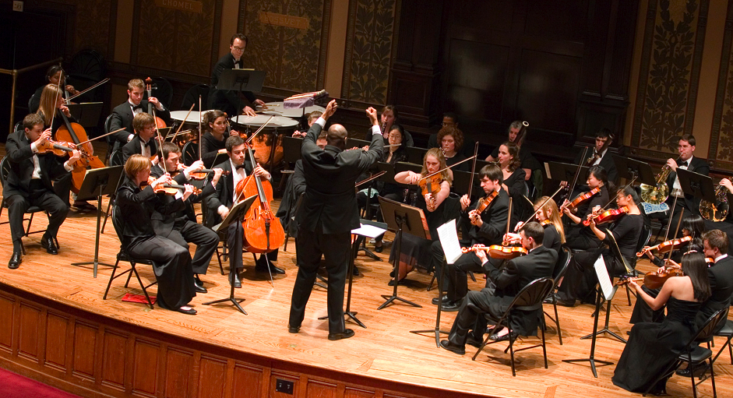
Notes:
The Picture of Leadership
Can The Pastor Conduct?
Every leader is there own worse enemy
Every leader has strengths and weaknesses – use your strength, incorporate others to your weakness.

Slide 21
ASSESSING ORGANIZATIONAL HEALTH OF A REGION
It is based upon the sum of the health of the parts (the churches).
It is the expression of the core values shared and embraced by the missional ministries of CBAmerica (8 regions and Chaplaincy)
Congregational Health
Effective Leadership
Church Multiplication

Slide 22
ASSESSING ORGANIZATIONAL HEALTH OF A REGION
It will include:
A survey sent to all the churches of the region
The gathering of historical data
Board Interview
Personal Interviews

Slide 23
ASSESSING ORGANIZATIONAL HEALTH OF A REGION
The final report will include:
Identification of strengths of the region
Identification of concerns for the region
Prescriptions for steps forward

Slide 24
Resources
MISSION DRIFT: THE UNSPOKEN CRISIS FACING LEADERS, CHARITIES, AND CHURCHES
By Peter Greer, Chris Horst
Meet Generation Z: Understanding and Reaching the New Post-Christian World
By James Emery White

